Slide 1
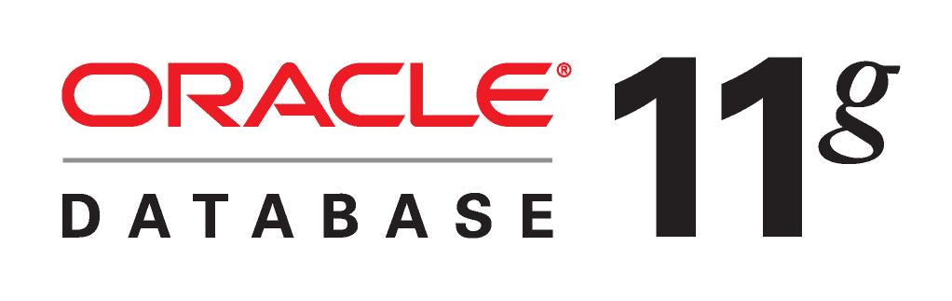
Practical 3

Slide 2
Creating Database Tables

Slide 3
Objectives
Become acquainted with Structured Query Language (SQL)
Learn about Oracle9i user schemas
Learn how to define Oracle9i database tables
Create database tables using SQL*Plus

Slide 4
Objectives
Learn how to debug SQL commands and use Oracle Corporation online help resources
Learn how to view information about your database tables using data dictionary views

Slide 5
Introduction to SQL
Structured Query Language (SQL): the standard query language for relational databases
Data definition language (DDL)
  Create new database objects
  Modify or delete existing objects.
Data manipulation language (DML)
  Insert, update, delete, and view database data.

Slide 6
Oracle User Accounts
User account - identified by a unique username and password
User schema - all of the objects that the user creates and stores in the database
Object owner has privileges to perform all possible actions on an object

Slide 7
Defining Database Tables
To create a new table specify:
  Table name
  Name of each data field
  Data type and size of each data field
Constraints: restrictions on the data values that a field can store
Oracle Naming Standard:
  Series of rules Oracle Corporation established for naming all database objects
  Objects must be from 1 to 30 characters long
  Can contain letters, numbers, and the special symbols $, _, and #
  Must begin with a character

Slide 8
Creating a Table
CREATE TABLE tablename
(fieldname1data_type,
(fieldname2 data_type,
…)

Slide 9
Oracle Data Types
Data type: specifies the kind of data that a field stores
Assigning a data type provides a means for error checking
Data types enable the DBMS to use storage space more efficiently by internally storing different types of data in different ways

Slide 10
Character Data Types
VARCHAR2
  Stores variable-length character data up to a maximum of 4,000 characters
  Values in different records can have a different number of characters
  fieldname VARCHAR2(maximum_size)

Slide 11
Character Data Types
CHAR
  Fixed-length character data up to a maximum size of 2,000 characters
  Data values for different records all have the same number of characters
  DBMS adds trailing blank spaces to the end of the entry to make the entry fill the maximum_size value
  Data longer than maximum_size causes an error
  fieldname CHAR[(maximum_size)]

Slide 12
Character Data Types
NVARCHAR2 and NCHAR
  Analogous to VARCHAR2 and CHAR but use Unicode rather than ASCII
  Used to hold character data in languages other than English

Slide 13
Number Data Types
Stores negative, positive, fixed, and floating point numbers between 10–130 and 10125, with precision up to 38 decimal places
General Syntax: fieldname NUMBER [([precision,] [scale])]
Integer: fieldname NUMBER(precision)
Fixed point: fieldname NUMBER[([precision],[scale])]
Floating point: fieldname NUMBER

Slide 14
Date and Time Data Types
DATE
  Dates from December 31, 4712 BC to December 31, 4712 AD
  Default format DD-MON-YY
  Default time format HH:MI:SS A.M.
  fieldname DATE
TIMESTAMP
  Similar to DATE but stores fractional seconds
  fieldname TIMESTAMP (fractional_seconds_precision)

Slide 15
Date and Time Data Types
INTERVAL YEAR TO MONTH
  Time interval, expressed in years and months
  +02-11 specifies a positive time interval of 2 years and 11 months
  fieldname INTERVAL YEAR[(year_precision)] TO MONTH
INTERVAL DAY TO SECOND
  Time interval, expressed in days, hours, minutes, and seconds
  -04 03:20:32.00: 4 days, 3 hours, 20 minutes, and 32 seconds
  fieldname INTERVAL DAY[(leading_precision)] TO SECOND[(fractional_seconds_precision)]

Slide 16
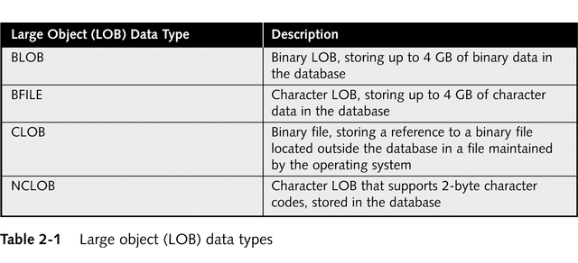
Large Object (LOB) Data Types

Slide 17
Constraints
Rules that restrict the data values that you can enter into a field in a database table
Integrity constraints: define primary and foreign keys
Value constraints: define specific data values or data ranges that must be inserted into columns and whether values must be unique or not NULL
Table constraint: restricts the data value with respect to all other values in the table
Field constraint: limits the value that can be placed in a specific field, irrespective of values that exist in other table records

Slide 18
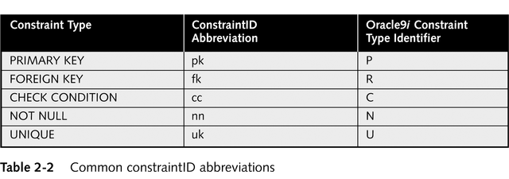
Oracle Constraint Naming Convention
tablename_ fieldname_constraintID

Slide 19
Integrity Constraints
Define primary key fields
Specify foreign keys and their corresponding table and column references
Specify composite keys

Slide 20
Value Constraints
Check conditions: field value must be a specific value or fall within a range of values
NOT NULL constraints: specify whether a field value can be NULL
Default constraints: specify that a field has a default value that the DBMS automatically inserts for every record, unless the user specifies an alternate value
Unique constraints: specify that a field must have a unique value for every table record

